Slide 1
Camera introduction
Author:Forrest Chen
Date: 29.07.2010
Version: 1.0

Slide 2
Still image capture
Video recording
Panorama capture
Camera architecture
View finder
Some features
S60 5.0 camera

Slide 3
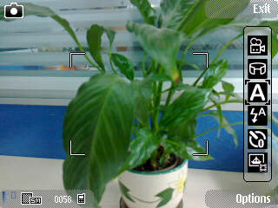
1. Still image capture
Tool bar:
Mode switch
Scene switch
Flash mode
Self timer
Single/sequence
Color tune
White balance
Exposure compensation
Sharpness
Contrast
Brightness
Light sensitivity
…
Reticle

Slide 4

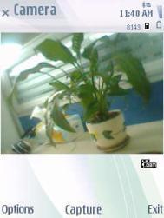
Some functions
(1)Zoom in/out
(2) Primary/secondary camera switch
(3)Setting
a. Image quality(5M/3M/0.3M)
b. Add to album(Yes/No)
c. Show captured image(On/Off)
d. Default image name(Date/Text)
e. Extended digital zoom(On/Off)
f. Capture tone(…)
g. Memory in use(phone, Mcard…)
h. GPS(On/Off)
i. Face tracking(On/Off)
…

Slide 5
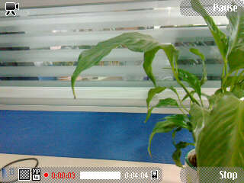
2.Video recording
Fewer functions in tool bar than still image
Scene switch
Video light switch
White balance
Color tone
Recording progress

Slide 6
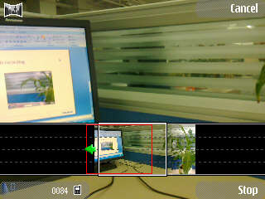
3. Panorama capture
Features
1.Only one direction when capturing
2. Don’t move up/down
3. Max number is 5
4. Output isn’t perfect

Slide 7
4. Camera architecture
Camera UI
Camera Engine
Camera API
Camera Driver

Slide 8
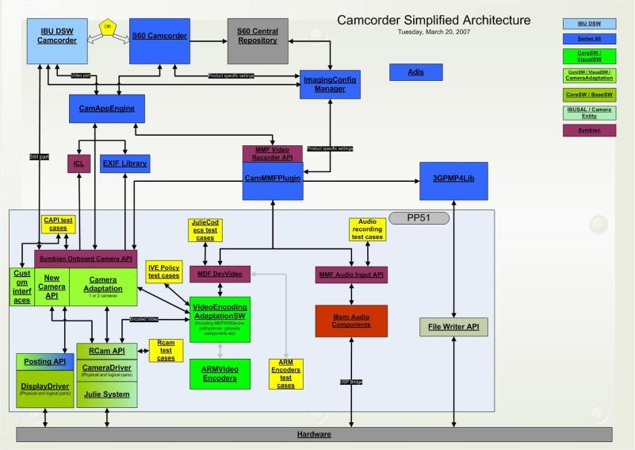
Image Conversion Library
Exchangeable File Format

Slide 9
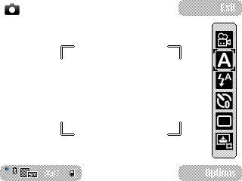
5. View finder
It’s 取景器 in Chinese. It has two working mode, bitmap and DSVF(direct screen view finder).
Bitmap mode: camera UI draws every frame sent by low layer
DSVF: camera UI do nothing, low layer draw every frame itself to screen by using DSA(direct screen access).
Snapshot for DSVF by screen grab tool

Slide 10
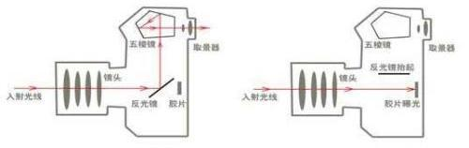
单镜头反光相机取景示意图
单镜头反光相机曝光示意图

Slide 11
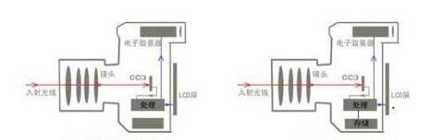
电子取景数码相机取景示意图
电子取景数码相机曝光示意图

Slide 12
6. Some features
Autofocus
Half press shutter key
Lens cover
Embedded mode
GPS support
Recording stability
Face tracking
…

Slide 13
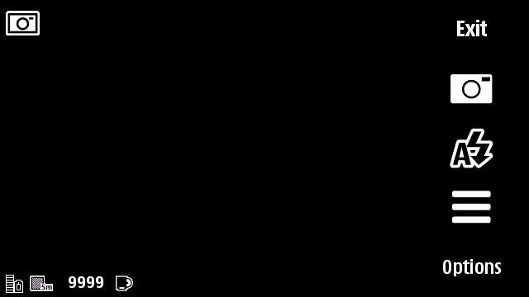
7. S60 5.0 camera
Touch screen
DSVF

Slide 14
The End, Thanks

